Slide 1
STM32 Home Work project
Using Timers to Generate PWM Signals
By :
1) Mohamed Mahdi
2) Mehdi Rejeb Kaâbia
3) Mohamed Safraou
2ATEL 1

Slide 2
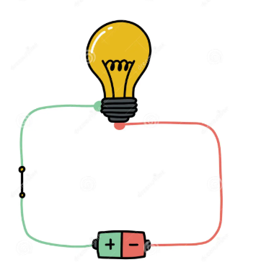
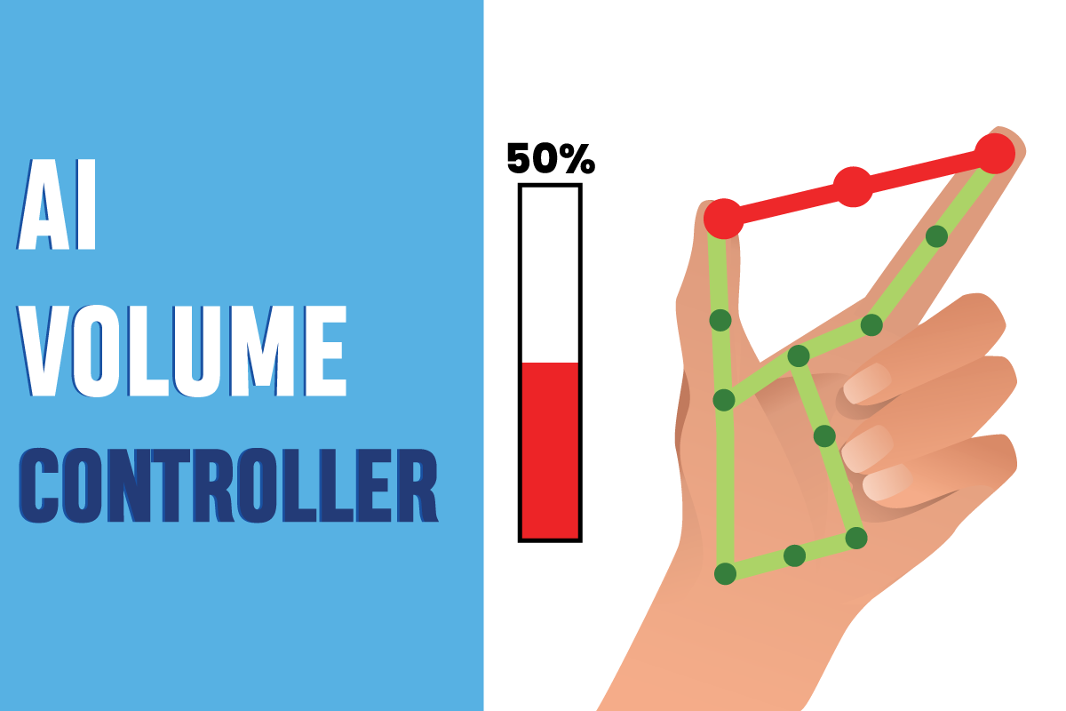
Gesture-Controlled LED Brightness Using PWM and STM32
Project Description:
The system allows users to control the LED brightness via hand gestures or a web interface, combining embedded systems, computer vision, and web development for an interactive solution.

Slide 3
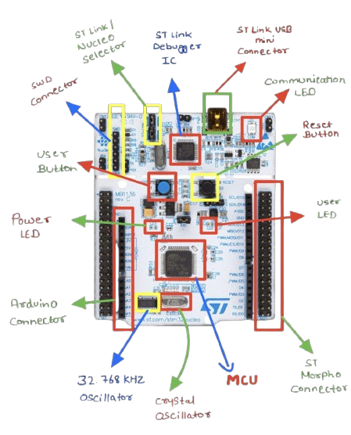
Gesture-Controlled LED Brightness Using PWM and STM32
Project Objectives:
Use the STM32 Nucleo F466RE board to generate a PWM signal for adjusting LED brightness.
Build a web interface with a slider ranging from 0 to 100, mapped to PWM values from 1 to 255.
Integrate Media Pipe for hand gesture control, enabling the slider to be adjusted based on the distance between two fingers.

Slide 4

Gesture-Controlled LED Brightness Using PWM and STM32
Duty Cycle in PWM and How It Works in STM32
Definition:
The duty cycle in Pulse Width Modulation (PWM) refers to the percentage of time the signal is "high" (on) within one period of the PWM signal.
Mathematical Formula:
Where:
  Pulse Width (T_high): The duration when the signal is high (on).
  Period (T_total): The total duration of one PWM cycle.
In STM32:
  Period is set by the timer's frequency.
  Pulse Width (T_high) is controlled by the compare register to determine how long the signal stays high.

Slide 5
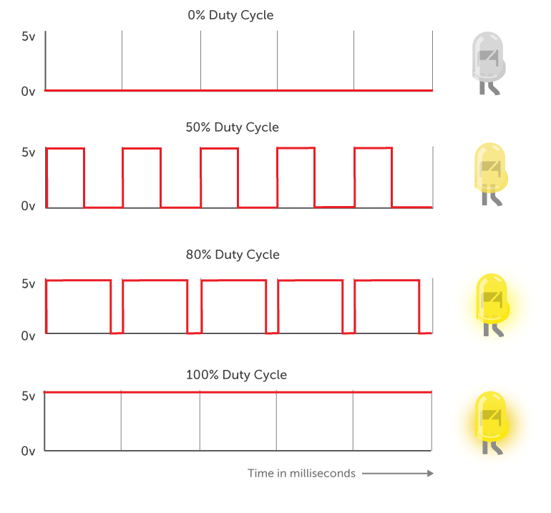
Gesture-Controlled LED Brightness Using PWM and STM32
How Duty Cycle Affects LED Brightness
The duty cycle in PWM directly controls the perceived brightness of an LED.
PWM Signal Behavior: The LED is rapidly switched on and off at a fixed frequency.
Higher Duty Cycle:
  When the duty cycle is higher, the LED stays on for a larger portion of each cycle.
  As a result, the LED appears brighter because it is "on" for a longer time.
Lower Duty Cycle:
  When the duty cycle is lower, the LED stays on for a shorter period and is off for a longer time.
  This causes the LED to appear dimmer, as the light output is less frequent.

Slide 6
Gesture-Controlled LED Brightness Using PWM and STM32
Hardware and Software Used
STM32 Board (STM32F4 or equivalent)
USB Camera for visual detection
STM32Cube IDE Development Environment
Web Server (FastAPI)
Web Interface developed in HTML/CSS with JavaScript interaction
OpenCV Library for computer vision
Python for computer vision processing
MediaPipe Library for finger detection and tracking
Uvicorn to run the web server asynchronously

Slide 7
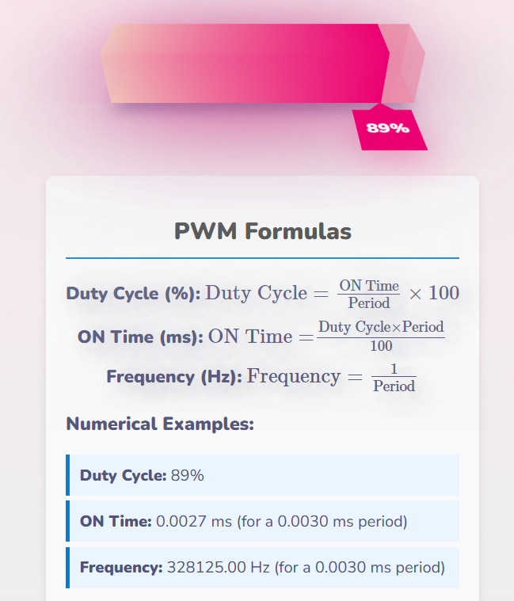
Gesture-Controlled LED Brightness Using PWM and STM32
System Architecture
Motion Detection:
A camera analyzes finger movements.
Computer vision detects the opening and closing of fingers.
A value from 0 to 100 is assigned based on finger spacing.
Web Interface:
A progress bar displays the current brightness value.
The user can adjust the brightness directly through this bar.
Server Communication with STM32:
The server sends the brightness value (as a signal) to the STM32 board via the UART cable.
STM32 Receiving and Processing the Signal:
The STM32 board receives the brightness signal via the UART cable.
The received signal is interpreted to determine the PWM duty cycle.
The STM32's PWM timer adjusts the LED intensity based on the interpreted value.

Slide 8
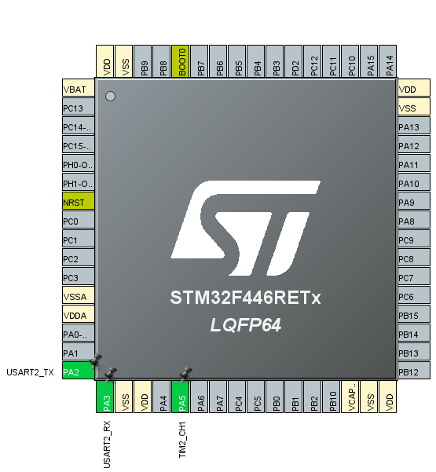
Gesture-Controlled LED Brightness Using PWM and STM32
STM32 Utilization and Port Configuration
The STM32 board is configured to control the LED through GPIO ports and a PWM timer. Specifically:
PA3 and PA2 are configured for UART communication, enabling data exchange between the STM32 and the server.
PA5 is set as the PWM output pin to drive the LED.
The PWM signal is generated by configuring Timer 2 (TIM2) in the STM32Cube IDE, where the duty cycle adjusts the LED brightness.
The GPIO pins are initialized in the firmware to handle LED output and data reception from the server.
The firmware running on the STM32 continuously listens for data transmitted from the server. When a brightness value (0-100) is received, the PWM duty cycle is updated to reflect the desired brightness.

Slide 9
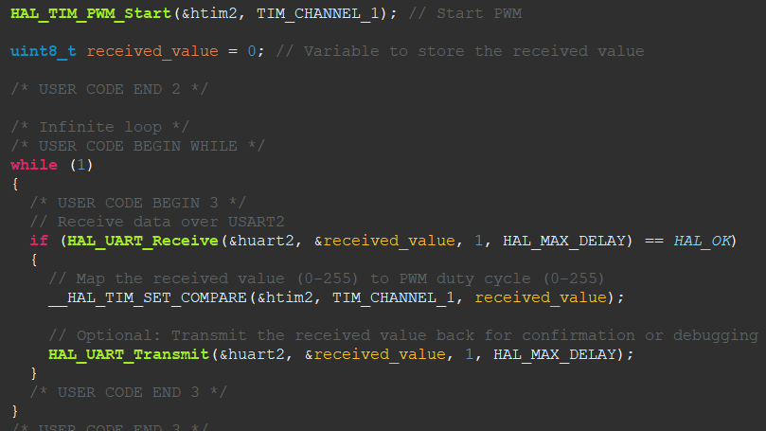
Gesture-Controlled LED Brightness Using PWM and STM32
Project Development
STM32 Board Configuration
Setting up the PWM timer.
Initializing GPIO to connect the LED.
Configuring PA3, PA2, and PA5 ports.
Programming the firmware to receive data from the server.

Slide 10
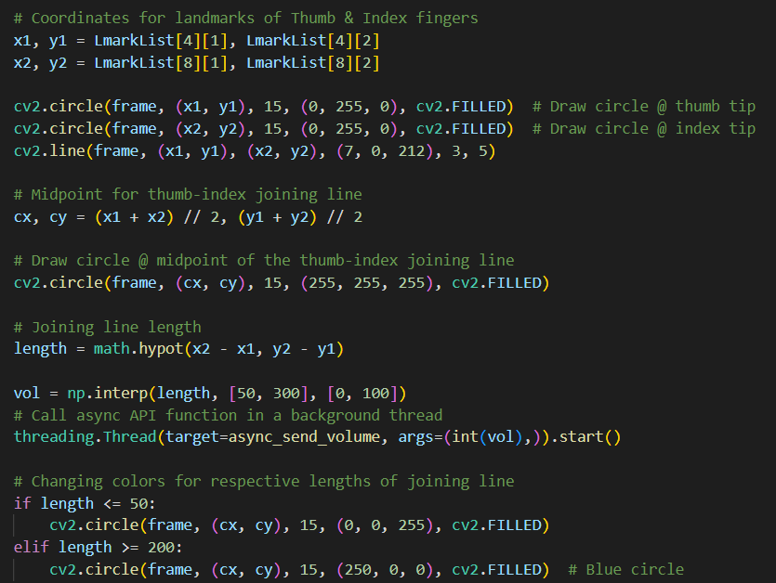
Gesture-Controlled LED Brightness Using PWM and STM32
Project Development
Computer Vision Development
Using Python and OpenCV to detect finger movements.
Implementing MediaPipe for accurate finger tracking and detection.
Converting detection data into brightness values.
Running the computer vision process with Uvicorn for asynchronous communication.

Slide 11
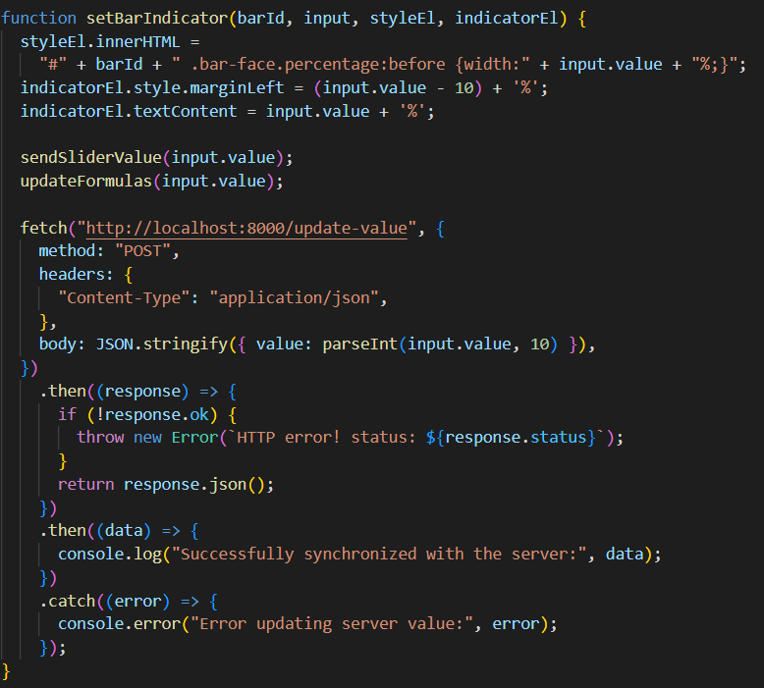
Gesture-Controlled LED Brightness Using PWM and STM32
Project Development
Web Interface Creation
Developing a simple interface with a progress bar.
Linking the interface to the server to send data to STM32.
Implementing Unicorn to handle server requests efficiently.

Slide 12
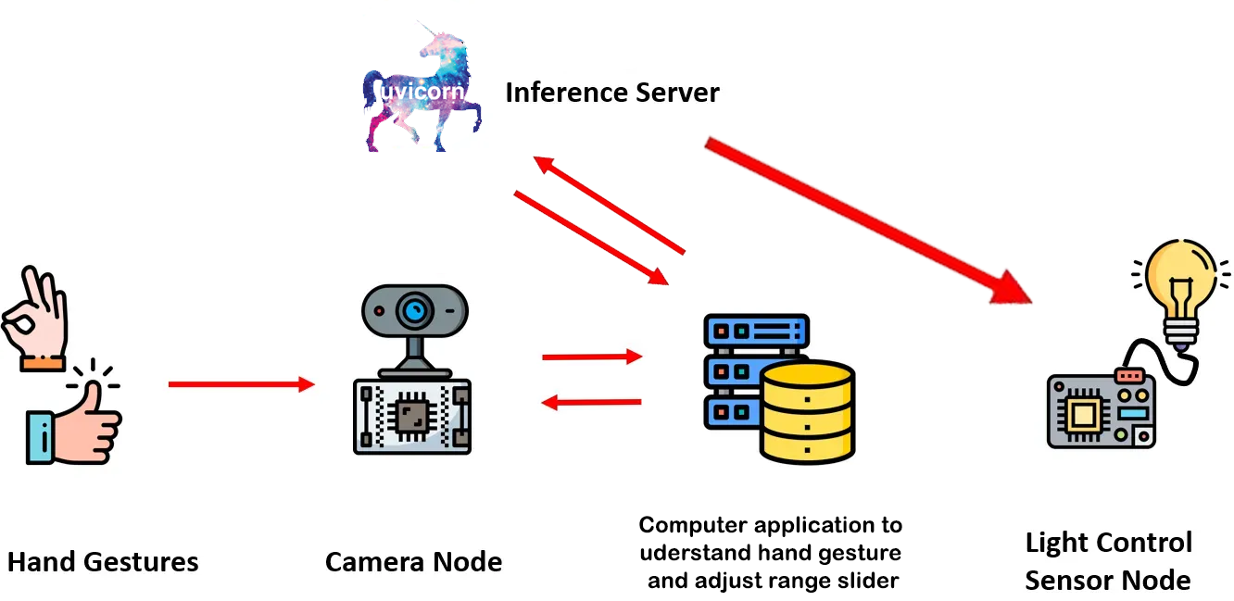
Gesture-Controlled LED Brightness Using PWM and STM32
Final Project Workflow

Slide 13
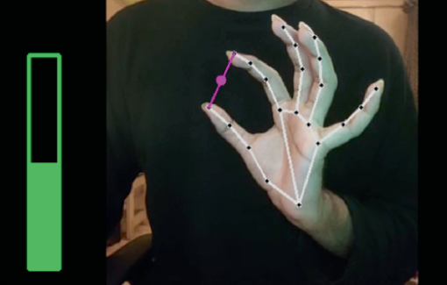
Gesture-Controlled LED Brightness Using PWM and STM32
Conclusion :
This project illustrates the integration of multiple technologies (STM32, PWM, computer vision, Python, and web) to create an interactive LED control system. The use of the STM32 microcontroller is essential due to its flexibility, cost-effectiveness, and powerful peripherals, making it ideal for real-time embedded applications. STM32’s efficient PWM control and UART communication capabilities facilitate seamless interaction between hardware and software, enhancing the overall performance and accuracy of the system.
Source code: https://github.com/Mahdyy02/khedmet-el-mrammeji

